Slide 1
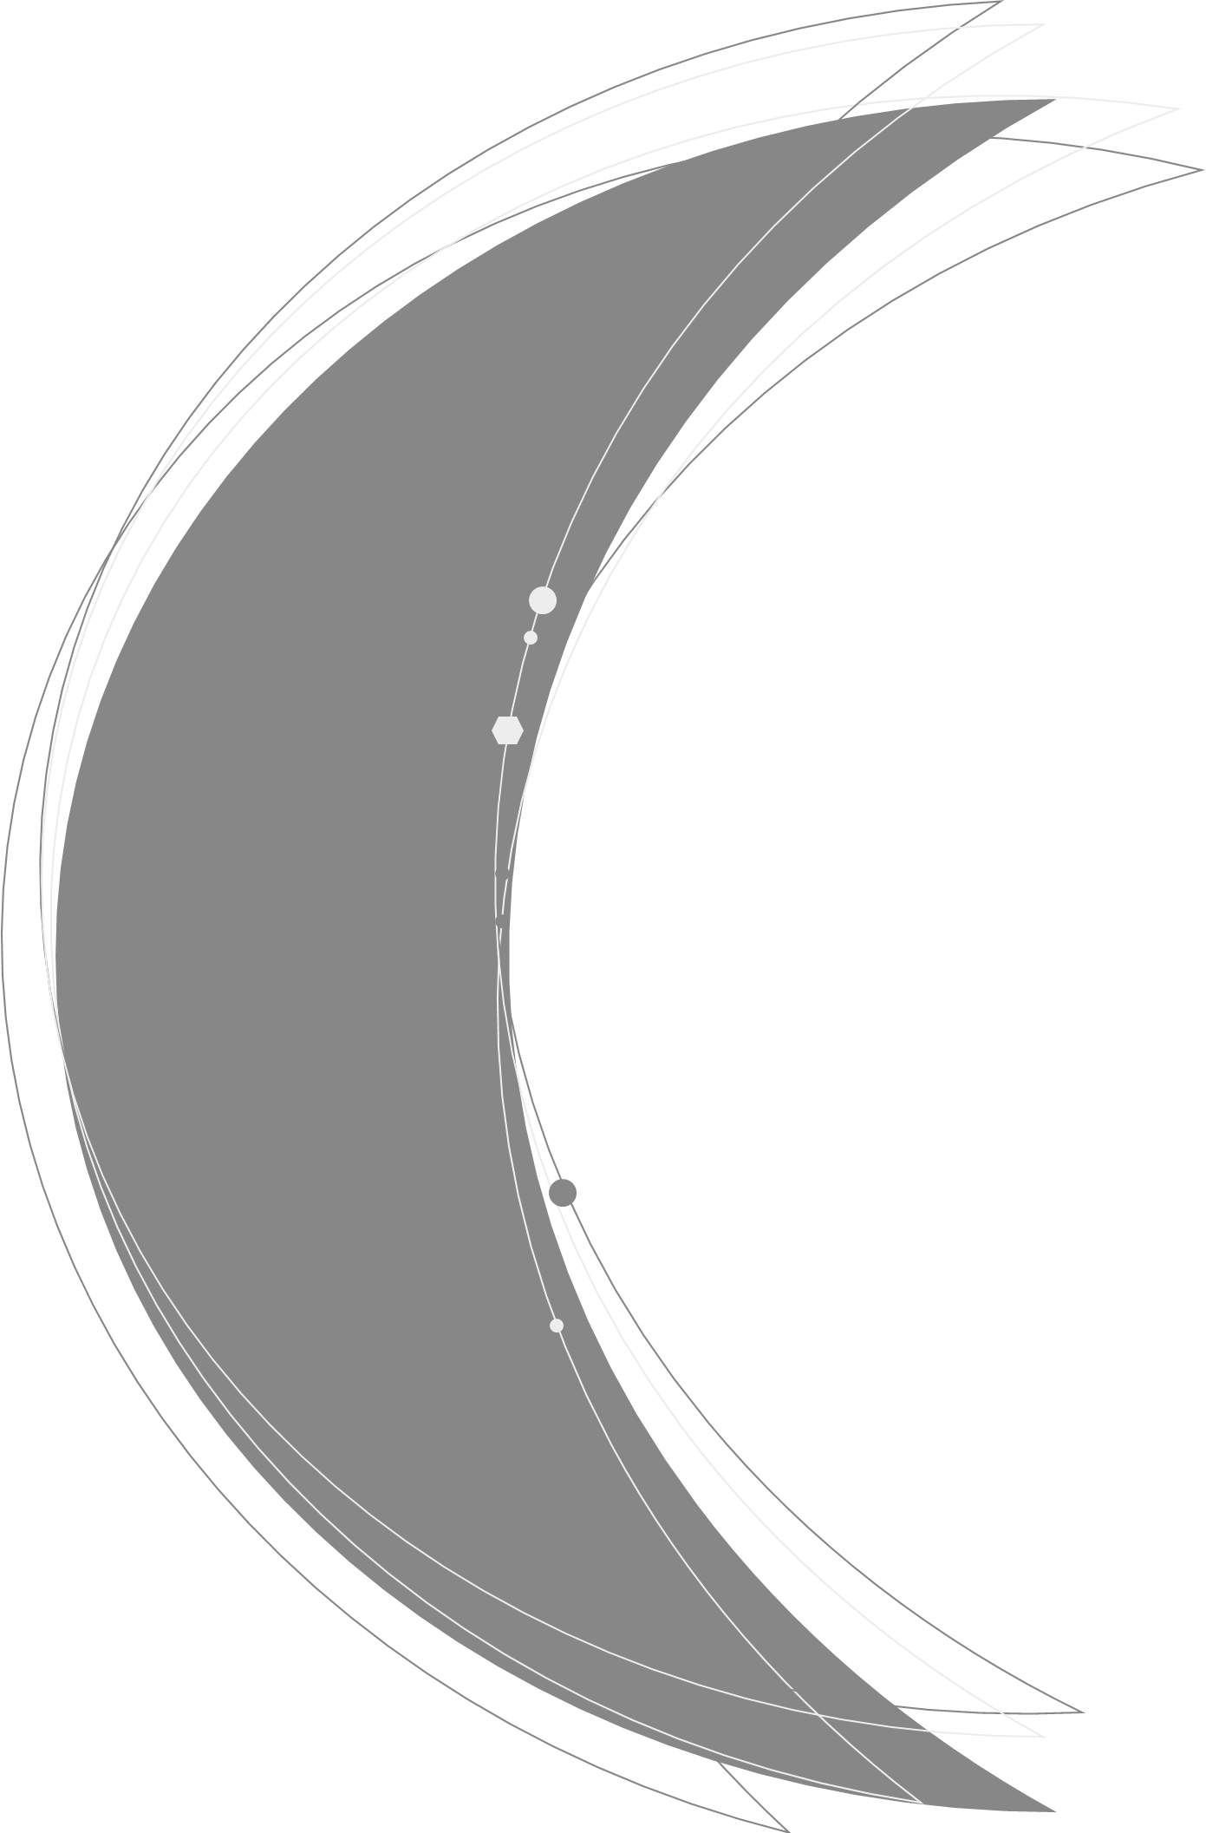
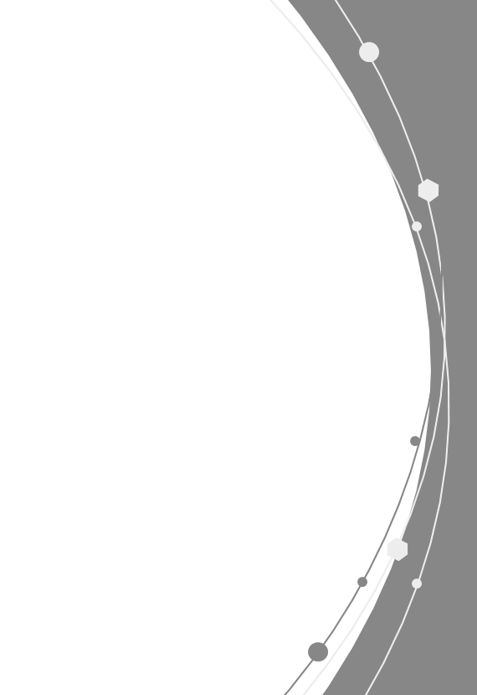
Lid-Driven Flow
in a Semi-Circular Cavity
using Lattice Boltzmann Method
- Compare three boundary treatments -
Soohwan Kim (ME PhD, Georgia Tech)
Notes:
You will learn some boundary treatment for curved geometry

Slide 2
Motivations
(1) Advance our friendly problem
(2) Implement LBM in curved boundaries
U
U
L
L
L
L
Lattice configurations?
Bounce-back conditions?

Slide 3
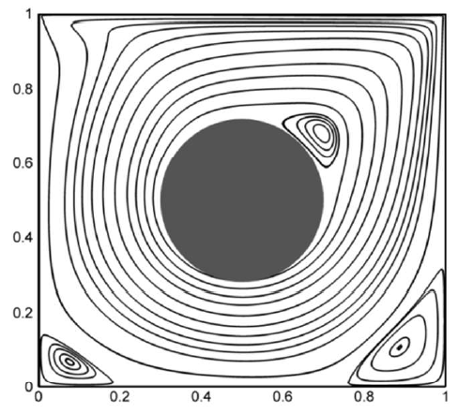
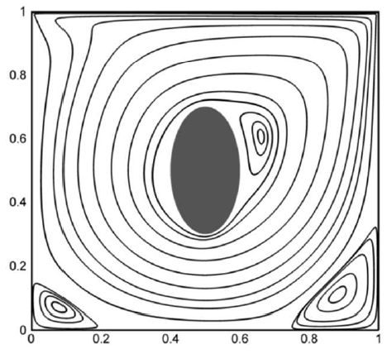
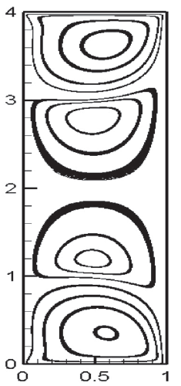
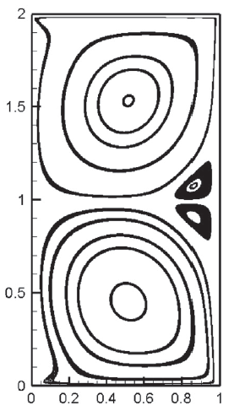
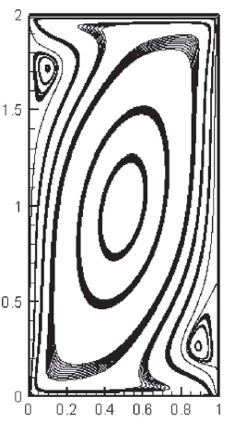
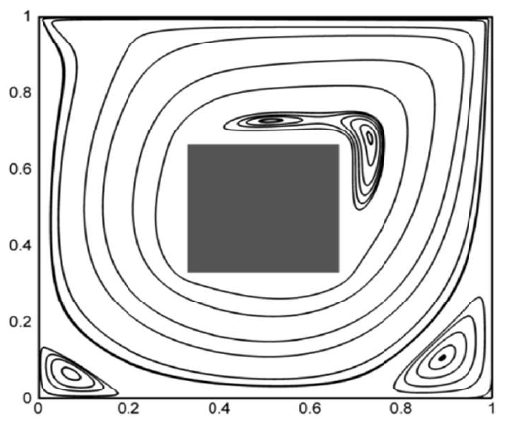
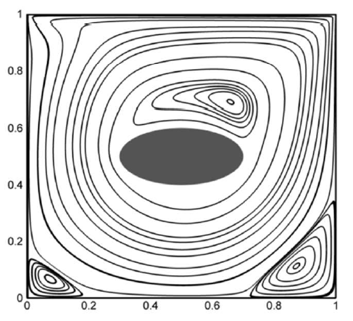
Former Studies
- Two-sided lid driven cavity
- Obstacles with different geometries
All Re = 1000
Arun, S., & Satheesh, A. (2015). Analysis of flow behaviour in a two sided lid driven cavity using lattice boltzmann technique. Alexandria Engineering Journal, 54(4), 795-806.
Rajan, I., & Perumal, D. A. (2021). Flow Dynamics Of Lid-Driven Cavities With Obstacles Of Various Shapes And Configurations Using The Lattice Boltzmann Method. Journal of Thermal Engineering, 7(2), 83-102.

Slide 4
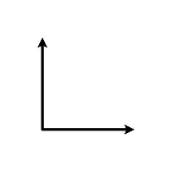
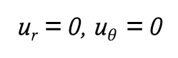



Problem Description
u = 1, v = 0
$$\frac{dP}{dn}=0$$
$$\frac{dP}{dn}=0$$
u = 0, v = 0
y
$$\frac{dP}{dn}=0$$
u_{r} = 0, u$θ$ = 0
x
Assumptions
- BGK collision operator
- D2Q9 model
- No slip, no penetration
- SRT model
- Incompressible
- Re = 100-1000
- Low Mach #

Slide 5
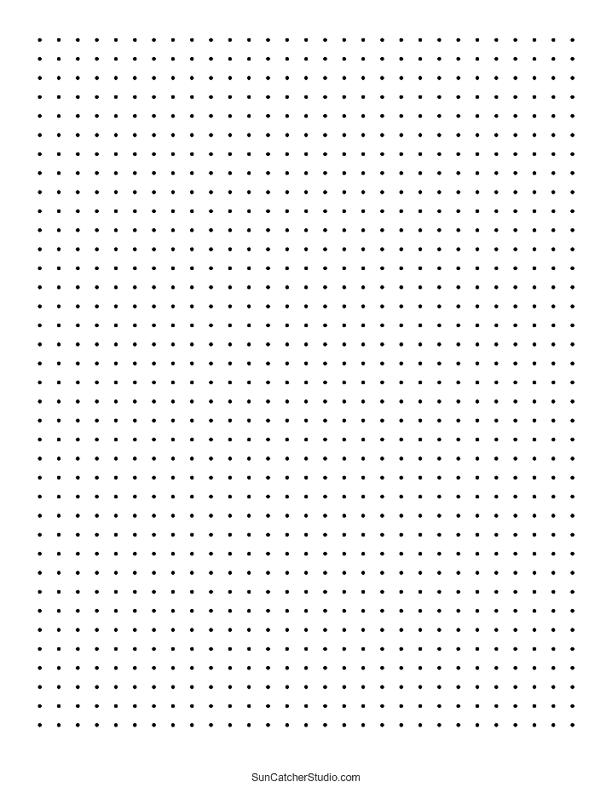
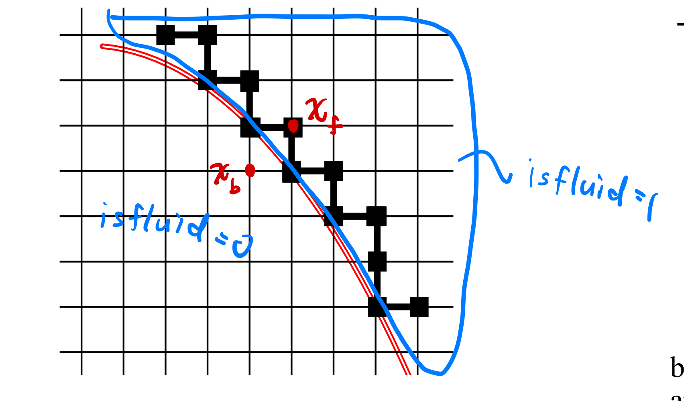
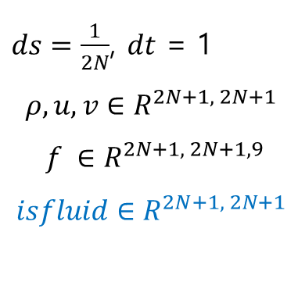


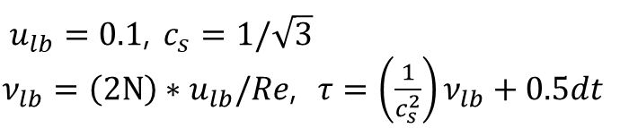
Lattice configurations
2N
$ds=\frac{1}{2N}$, $dt$ = 1
$$ρ, u, v∈R^{2N+1, 2N+1}$$
$$f ∈R^{2N+1, 2N+1,9}$$
$$isfluid∈R^{2N+1, 2N+1}$$
N
$$fluid$$
y
x
$u_{lb}=0.1$, $c_{s}=1/\sqrt{3}$
$ν_{lb}=\left(2N\right)∗u_{lb}/Re$, $τ=\left(\frac{1}{c_{s}^{2}}\right)ν_{lb}+0.5dt$
$$wall$$
Mei, R., Shyy, W., Yu, D., & Luo, L. S. (2000). Lattice Boltzmann method for 3-D flows with curved boundary. Journal of Computational Physics, 161(2), 680-699.

Slide 6
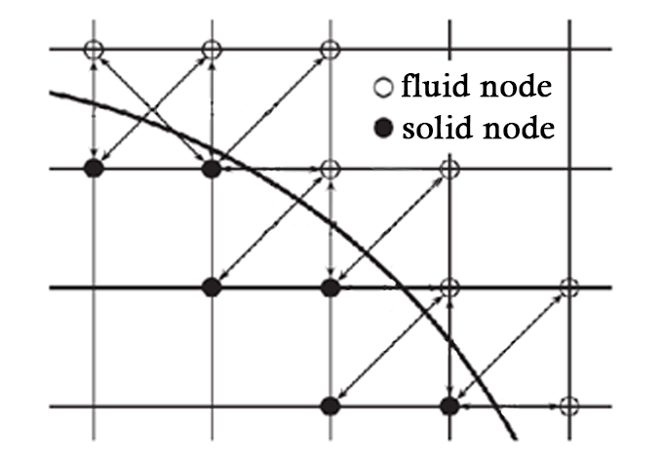
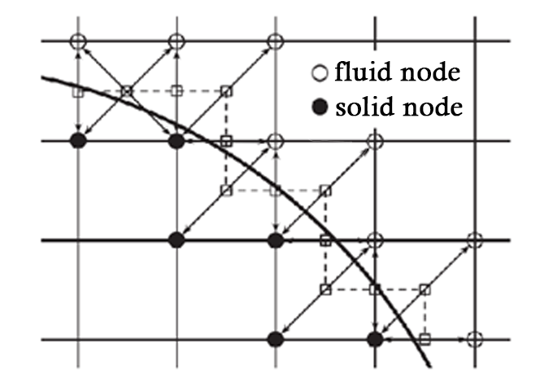
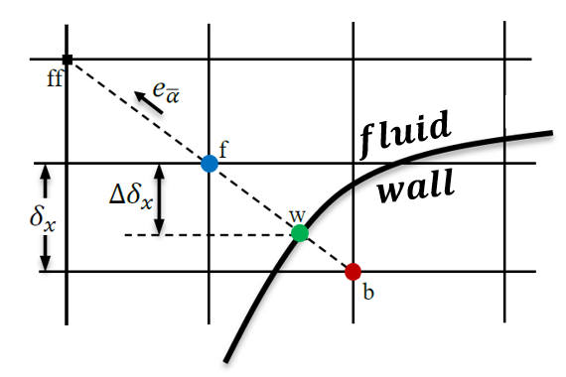
Three Approaches
Staircase approximation
full-way bounce-back
Staircase approximation
half-way bounce-back
Interpolation
Complexity & Accuracy
Li, Q., Yu, Y., & Luo, K. H. (2019). Implementation of contact angles in pseudopotential lattice Boltzmann simulations with curved boundaries. Physical Review E, 100(5), 053313.

Slide 7
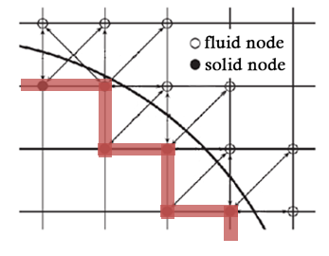
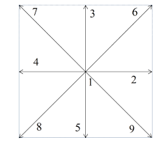


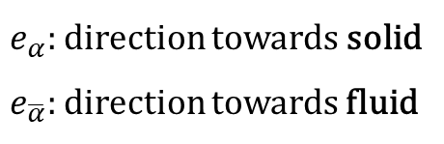
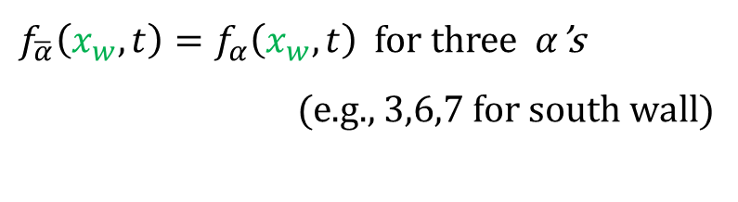


Staircase Full-way Bounce-back
$$e_{\overline{α}}$$
w
$$e_{\overline{α}}$$
w
$$e_{α}$$
$$e_{α}$$
$e_{α}:$ direction towards solid
$e_{\overline{α}}:$direction towards fluid
$f_{\overline{α}}\left(x_{w},t\right)=f_{α}\left(x_{w},t\right)$ for three $α$’s
(e.g., 3,6,7 for south wall)

Slide 8
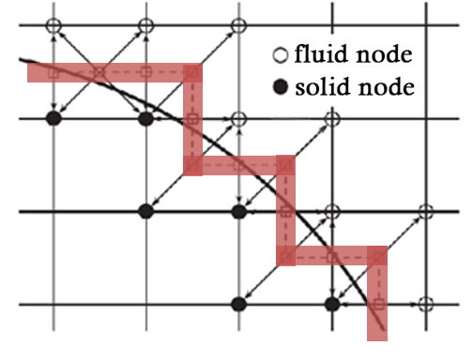
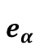
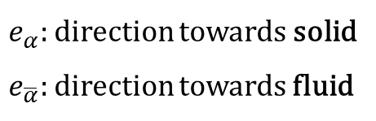

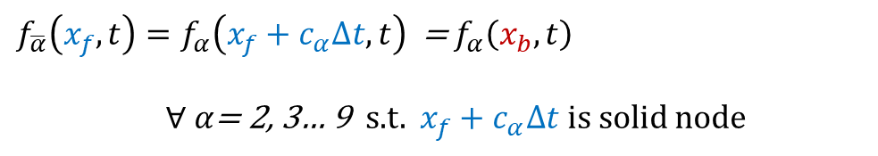
Staircase Half-way Bounce-back
$$e_{\overline{α}}$$
f
$e_{α}:$ direction towards solid
$e_{\overline{α}}:$direction towards fluid
b
$$e_{α}$$
$f_{\overline{α}}\left(x_{f},t\right)=f_{α}\left(x_{f}+c_{α}∆t,t\right)$ = $f_{α}\left(x_{b},t\right)$
$∀ α$= 2, 3… 9 s.t. $x_{f}+c_{α}∆t$ is solid node

Slide 9
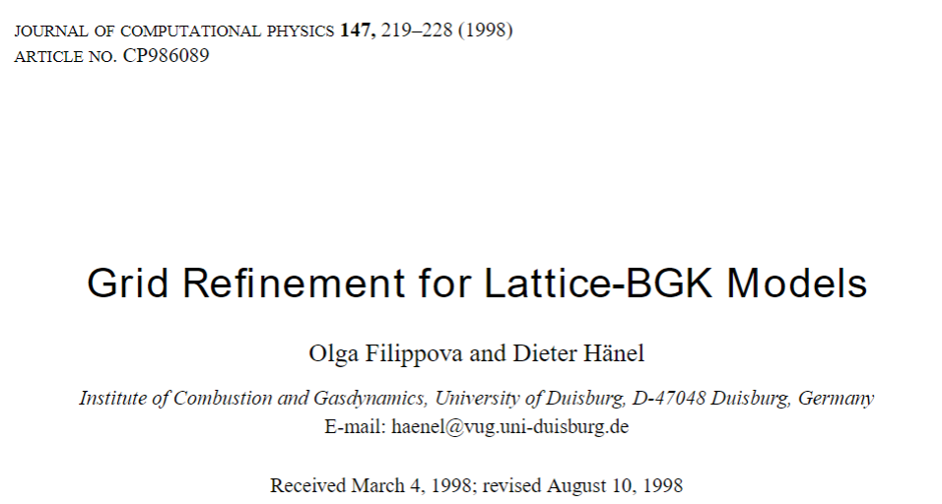
Interpolation Methods for Curved Boundary
Filippova and Hanel (1998) → Mei et al. (1999)
→ Bouzidi et al. (2001) → Yu et al. (2003)
citations: 846
783
1320
1146
Filippova, O., & Hänel, D. (1998). Grid refinement for lattice-BGK models. Journal of computational Physics, 147(1), 219-228.
Mei, R., Luo, L. S., & Shyy, W. (1999). An accurate curved boundary treatment in the lattice Boltzmann method. Journal of computational physics, 155(2), 307-330.
Bouzidi, M. H., Firdaouss, M., & Lallemand, P. (2001). Momentum transfer of a Boltzmann-lattice fluid with boundaries. Physics of fluids, 13(11), 3452-3459.
Yu, D., Mei, R., Luo, L. S., & Shyy, W. (2003). Viscous flow computations with the method of lattice Boltzmann equation. Progress in Aerospace sciences, 39(5), 329-367.
Notes:
I did not take a close look at the derivation of these equations but just use them to recreate in my coding
I took a look at some review papers
Farrokhpanah, A., Nabovati, A., & Mostaghimi, J. (2014). Study of curved boundary treatments in lattice Boltzmann method. In Proceedings of The Canadian Society for Mechanical Engineering International Congress.

Slide 10
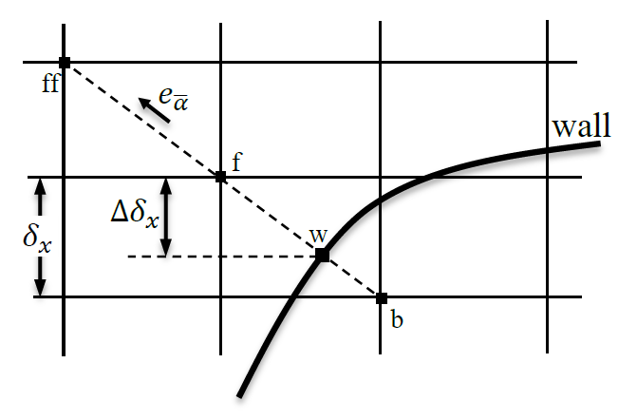
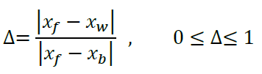

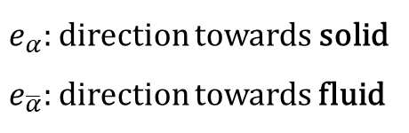
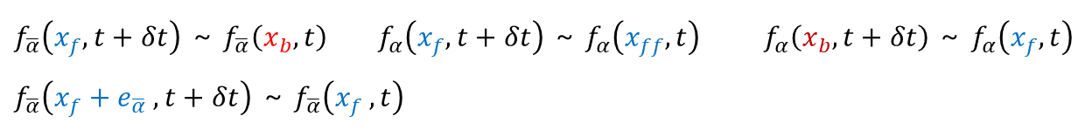
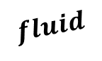
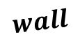
Interpolation Method (Yu et al.)
$$fluid$$
$$wall$$
$e_{α}:$ direction towards solid
$e_{\overline{α}}:$direction towards fluid
After streaming, we have $f_{α}\left(x_{f},t+δt\right)$ and $f_{α}\left(x_{b},t+δt\right)$,
Linear interpolation: $f_{α}\left(x_{w},t+δt\right)=f_{α}\left(x_{f},t+δt\right)+Δ\left[f_{α}\left(x_{b},t+δt\right)−f_{α}\left(x_{f},t+δt\right)\right]$
Momentum balance: $f_{\overline{α}}\left(x_{w},t+δt\right)=f_{α}\left(x_{w},t+δt\right)+2w_{α}ρ_{w}\left(\frac{3}{c^{2}}\right)e_{α}u_{w}$ ($u_{w}$ = 0 in fixed wall)
Linear interpolation: $f_{\overline{α}}\left(x_{f},t+δt\right)=f_{\overline{α}}\left(x_{w},t+δt\right)+\frac{Δ}{1+Δ}[f_{\overline{α}}\left(x_{f}+e_{\overline{α}} ,t+δt\right)−f_{\overline{α}}\left(x_{w} ,t+δt\right)]$
$f_{\overline{α}}\left(x_{f},t+δt\right)$ ~ $f_{\overline{α}}\left(x_{b},t\right)$ $f_{α}\left(x_{f},t+δt\right)$ ~ $f_{α}\left(x_{ff},t\right)$ $f_{α}\left(x_{b},t+δt\right)$ ~ $f_{α}\left(x_{f},t\right)$
$f_{\overline{α}}\left(x_{f}+e_{\overline{α}} ,t+δt\right)$ ~ $f_{\overline{α}}\left(x_{f} ,t\right)$
Yu, D., Mei, R., Luo, L. S., & Shyy, W. (2003). Viscous flow computations with the method of lattice Boltzmann equation. Progress in Aerospace sciences, 39(5), 329-367.
Notes:
direction of the particle momentum moving

Slide 11
Algorithm
Initialization
Collision
BC Treatment
Curved fixed wall
Flat moving wall
Reconstruction
Calculate $ρ, u, v$
Calibrate $ρ,=ρ_{0} , u=0, v=0$ for solid nodes
Reconstruction
Calculate 𝜌, 𝑢, 𝑣
Calibrate 𝜌,=𝜌_0 , 𝑢=0, 𝑣=0 for solid nodes
Streaming
Iteration
until norm of u < 10⁻⁵
Notes:
Vorticity contour

Slide 12
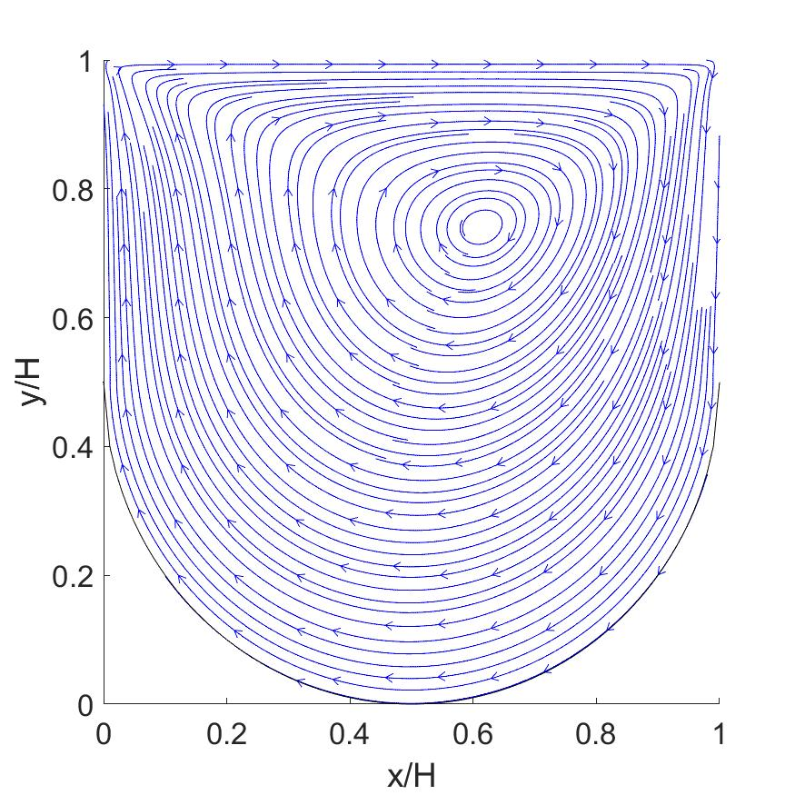
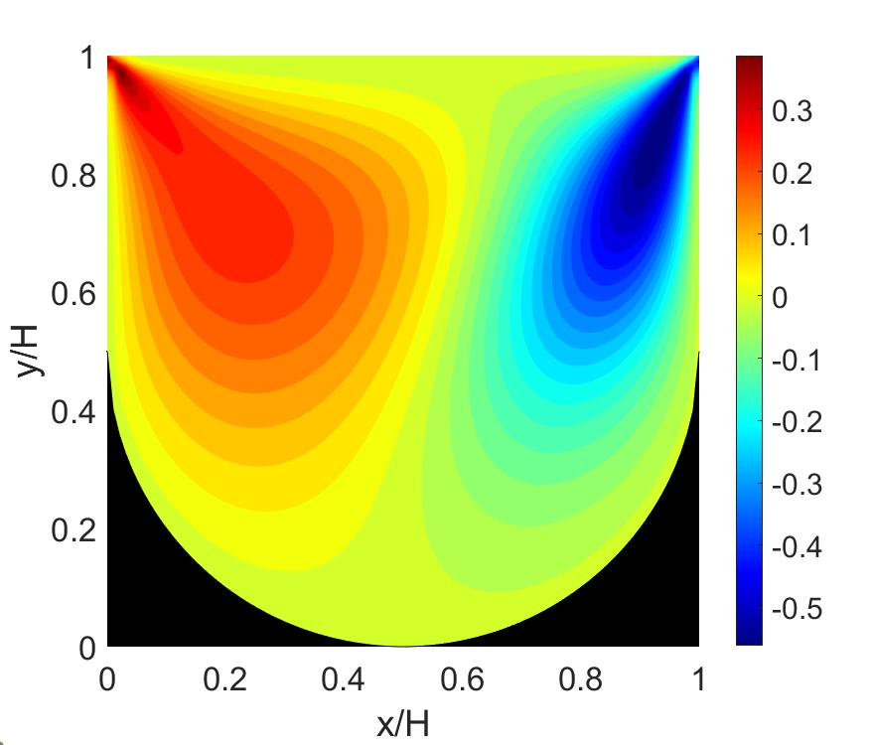
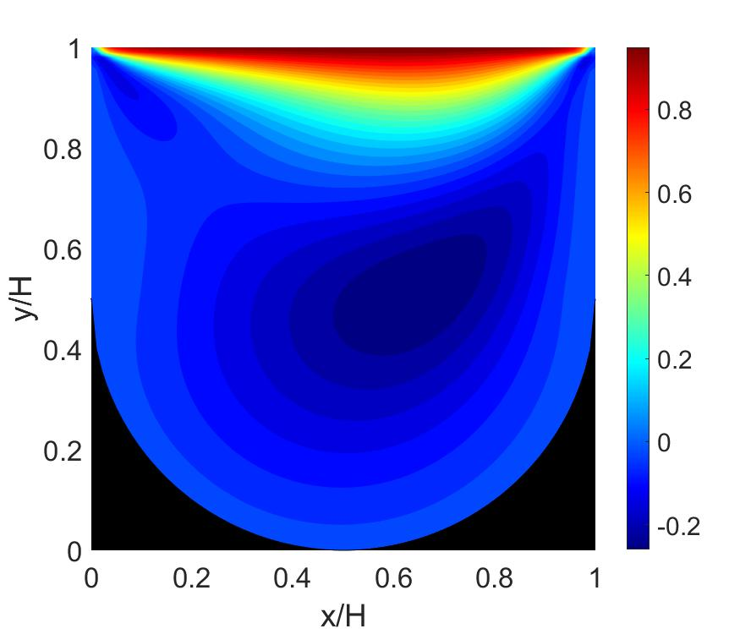
Results - Interpolation Method
Streamlines
u field
v field
N = 50
Re = 100
Notes:
Vorticity contour
Half-way bounce back
This method gives second order
accuracy in simple geometries15 such as laminar flow
through parallel plates, but reduces to first order accuracy
in more complicated geometries.
Cosgrove, J. A., Buick, J. M., Tonge, S. J., Munro, C. G., Greated, C. A., & Campbell, D. M. (2003). Application of the lattice Boltzmann method to transition in oscillatory channel flow. Journal of Physics A: Mathematical and General, 36(10), 2609.
Chen, S., Martinez, D., & Mei, R. (1996). On boundary conditions in lattice Boltzmann methods. Physics of fluids, 8(9), 2527-2536.
He, X., Zou, Q., Luo, L. S., & Dembo, M. (1997). Analytic solutions of simple flows and analysis of nonslip boundary conditions for the lattice Boltzmann BGK model. Journal of Statistical Physics, 87(1), 115-136.

Slide 13
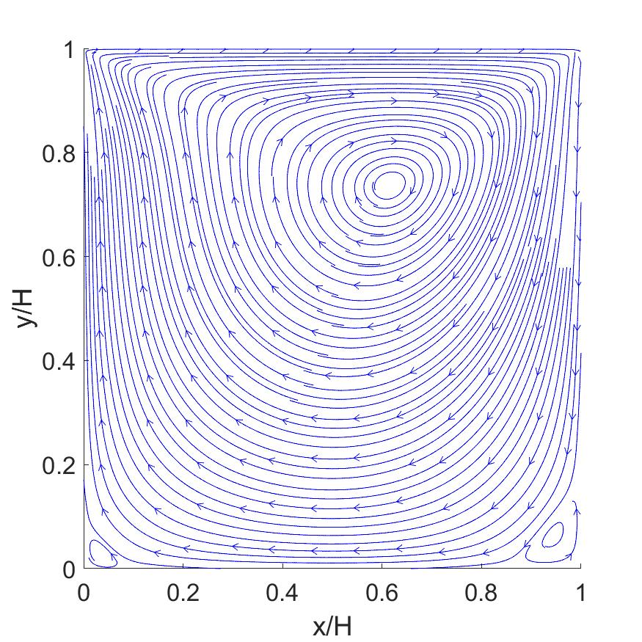
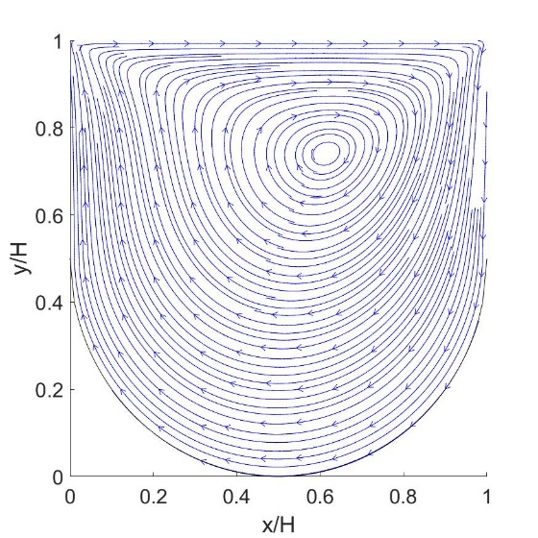
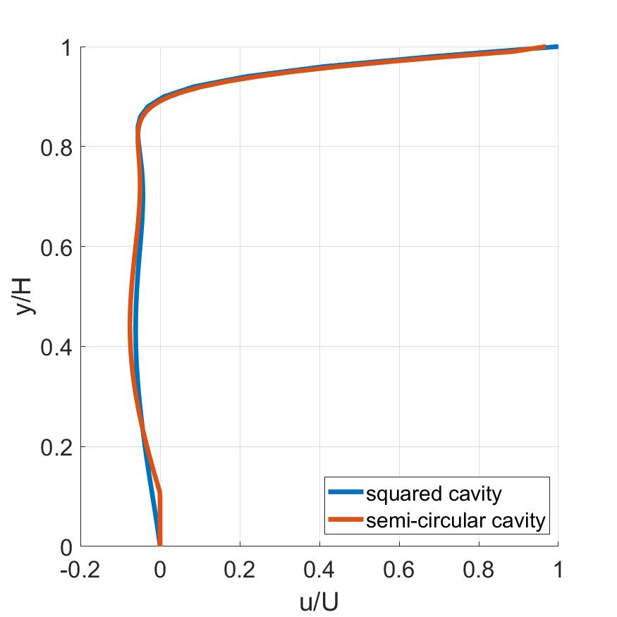
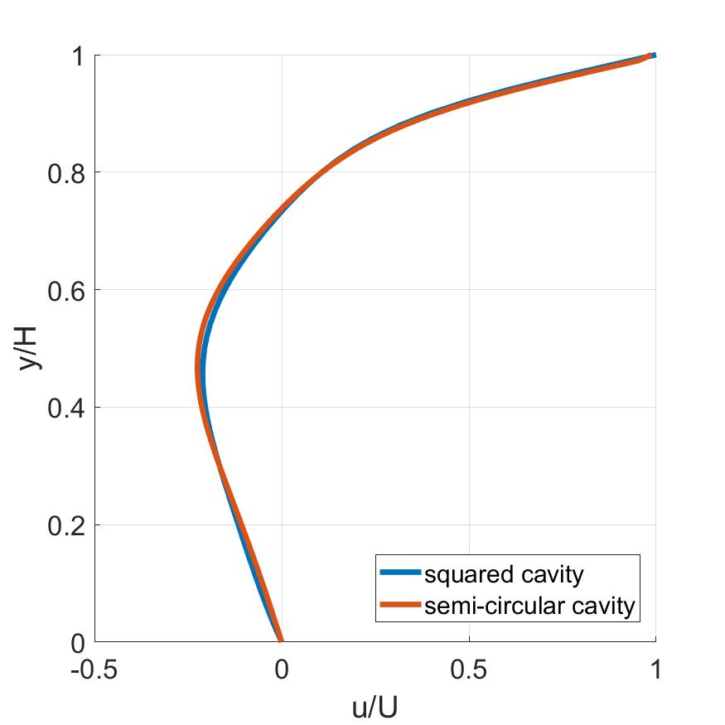

Comparison with Square Cavity (Re = 100)
Streamlines
u profile (x/H = 0.2, 0.5, 0.8)
Notes:
Vortex core location

Slide 14





Comparison with Square Cavity (Re = 400)
Streamlines
u profile (x/H = 0.2, 0.5, 0.8)
Notes:
Vortex core location

Slide 15


Effects of Reynolds Number
Re = 100
Re = 400
Re = 1000
N = 50
Interpolation method
Re = 100 - 1000

Slide 16



Results – Comparisons of Three Methods
Staircase approximation
full-way bounce-back
Staircase approximation
half-way bounce-back
N = 50
Re = 100
Interpolation
Centerline u profile

Slide 17


Results – Convergence Comparison
N = 50
Re = 100
Ground-truth:
(N=250, Interpolation)
Centerline u profile
↓ Time taken in seconds using MATLAB (Intel i5 processor)
# of iterations | Stair full | Stair half | Interpolation
1000 | 3.8 | 3.5 | 5.6
2000 | 6.6 | 6.6 | 10.8
Notes:
Re 100
1e-5 criteria
Full 7461-23.6s 2000-6.6s 1000- 3.8s 500-1.8s
Half 7475-23.0s 2000-6.6s 1000-3.5s 500-1.8s
Yu 8885-46.0s 2000-10.8s 1000-5.6s 500-2.9s

Slide 18
RMS Error and Spatial Convergence Rate
Re = 100
Ground truth (N=250, interpolation)
N | 10 | 25 | 50 | 100
Full Bounce-back | unstable | 0.0136 | 0.0125 | 0.0121
Half Bounce-back | 0.0167 | 0.0135 | 0.0125 | 0.0121
Interpolation | 0.0170 | 0.0137 | 0.0126 | 0.0121
RMS error with ground truth
→ Interpolation is the most computationally heavy but all methods have similar levels of accuracy
Notes:
N 10 25 50 100
Full unstable 0.0136 0.0125 0.0121
Half 0.0167 0.0135 0.0125 0.0121
Yu 0.0170 0.0137 0.0126 0.0121
Theoretically, D2Q9 method with explicit discretization has 2nd order convergence in space and time

Slide 19

LBM without BC Implementation
Initialization
Collision
BC Treatment
Reconstruction
‘only’ in fluid nodes
(where isfluid = 1)
Streaming
Iteration
until norm of u < 10⁻⁵

Slide 20
Other Ideas
U
U
U
Semi-circular cavity
without side walls
Circular cavity
with moving curved lid

Slide 21



Comparison with Literatures
Re = 1000
Visualization (Re = 1000)
Re = 400
LBM (no BC)
Migeon, C., Texier, A., & Pineau, G. (2000). Effects of lid-driven cavity shape on the flow establishment phase. Journal of Fluids and Structures, 14(4), 469-488.
Notes:
discrete solid tracers both coupled with a laser sheet illumination

Slide 22
Conclusion
- Employed three schemes for curved boundary treatment :
(1) staircase approximation with full-way bounce-back,
(2) staircase approximation with half-way bounce-back,
(3) interpolation method suggested by Yu et al. (2003)
→ the interpolation is the most computationally heavy but other two methods showed decent accuracy
- LBM implementation within fluid nodes without BC treatment seems effective but may not convey the complete physics
(2) Implement LBM in curved boundaries

